Slide 1


CAPSTONE PROJECT PYTHON
ARVIND K

Slide 2
PROJECT INTRODUCTION
The objective of the Capstone is to demonstrate the ability to use
MySQL
Python
Tableau
We are provided with different business scenarios that we need to analyze using these three technologies, explain our methodology and derive a conclusion
MySQL
python
tableau

Slide 3
DESCRIPTION OF DATASET
A production company wants to analyze a movie dataset to identify what kinds of movies perform well in cinemas, which genres they belong to, and so on. It will help the company predict if a movie will be a commercial success, if the movie with be highly rated, etc.
We use the data provided in CSV format to perform the required analysis
The data contains 20 columns with data related to movie details, revenue, popularity and voting

Slide 4
DATA DICTIONARY
Budget: The budget of a movie in dollars.
Genres: The genre of the movie and TMDB id
Homepage: The official homepage URL of a movie
Id: IMDB id of a movie
Keywords: TMDB id and names of all keywords
Original_language: Two-digit code of the language in which the movie was made
Original_title: The original title of a movie
Popularity: Popularity of the movie
Overview: Brief description of the movie
Production_companies: All production companies' names and TMDB id of a movie
Production_countries: Two-digit code and the full name of the production country
Release_date: The release date of a movie
Revenue: The total revenue earned by a movie
Runtime: The total runtime of a movie in minutes
Spoken_languages: Two-digit code and the full name of the spoken language
Status: The status of the movie (postproduction, released, or rumored)
Vote_average: Average vote for a movie
Vote_count: The total vote count for a movie
Tagline: Tagline of a movie
Title: English title of a movie

Slide 5
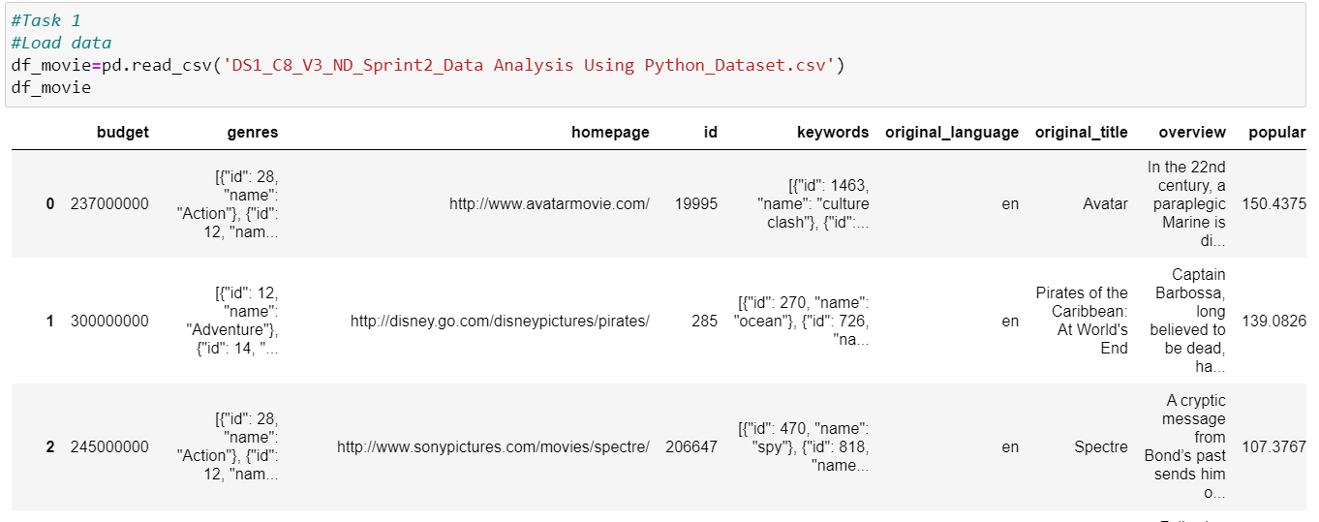
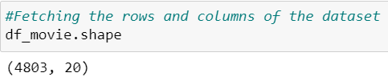
TASK 1
Load the dataset
Number of rows and columns
Interpretation
There are 4803 rows and 20 columns in this dataset

Slide 6
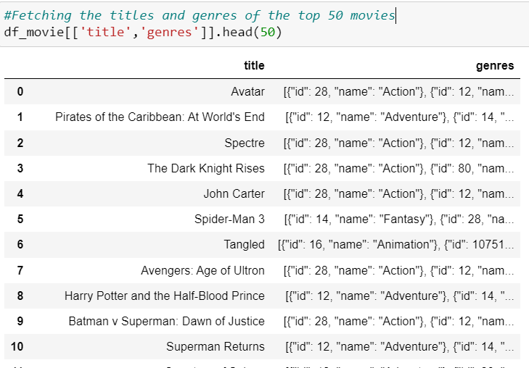
TASK 1 cont.
Titles and genres of the first 50 movies
Interpretation
There are 23 Action movies in the top 50 movies

Slide 7
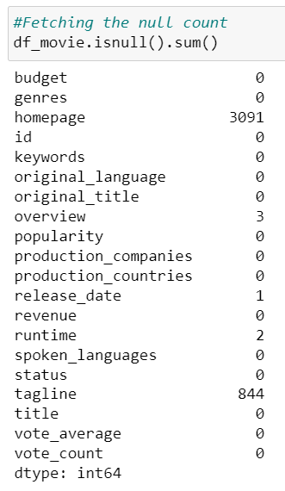
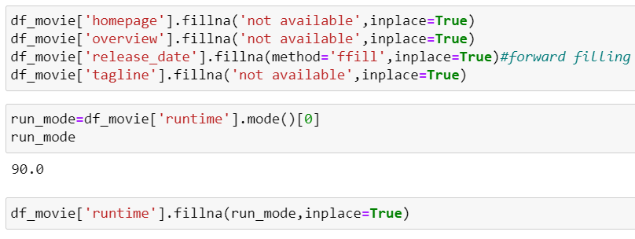
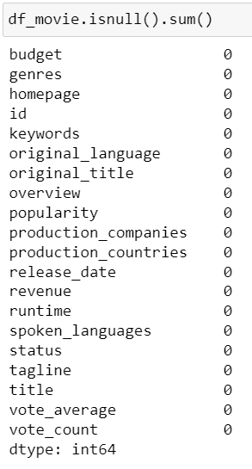
TASK 2
Null check after imputation
Null value check
Data Imputation
Interpretation
The columns homepage, overview, release_date, runtime and tagline have null values in them. Since homepage, overview and tagline are unique for each movie, null is replaced by ‘not available’. For release_date, forward filling is done as there is only one null. For runtime, the mode of the values is filled as the runtime can be similar for most movies.

Slide 8
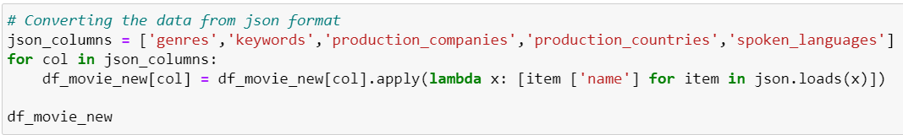
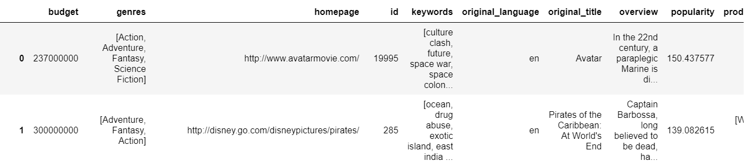
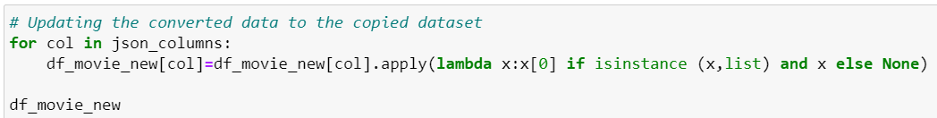
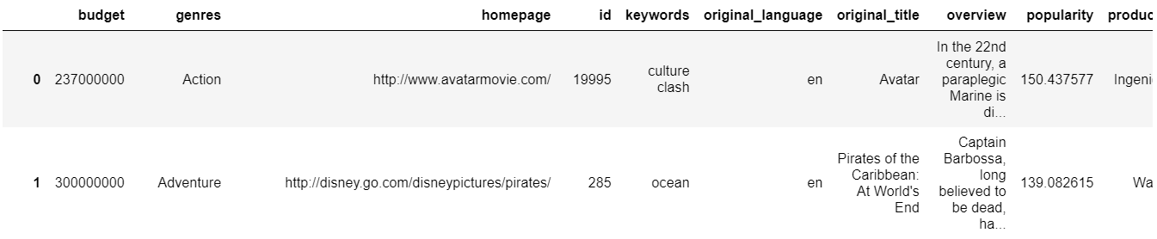
Converting data from JSON
Interpretation
The values from the columns genres, keywords, production_companies, production_countries, spoken_languages are retrieved from JSON format

Slide 9
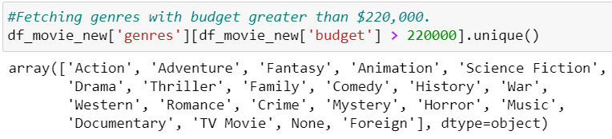
TASK 3
Movie categories with budget greater than $220,000
Interpretation
The movies with budget greater than $220,000 fall under the categories Action, Adventure, Fantasy, Animation, Science Fiction, Drama, Thriller, Family, Comedy, History, War, Western, Romance, Crime, Mystery, Horror, Music, Documentary, TV Movie and Foreign.

Slide 10
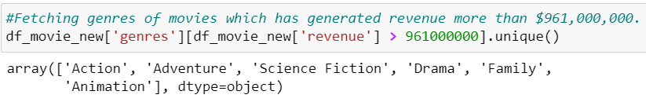
TASK 4
Movie categories where revenue is greater than $961,000,000
Interpretation
The movie categories with revenue more than $961,000,000 are Action, Adventure, Science Fiction, Drama, Family, Animation

Slide 11
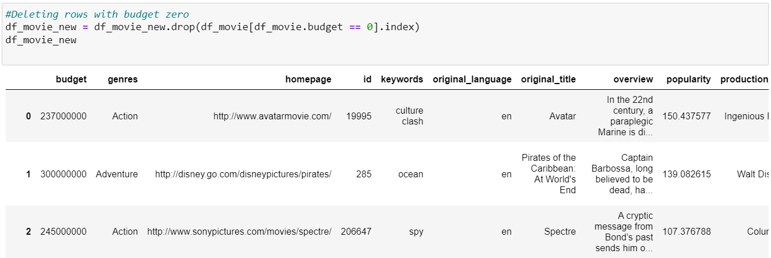
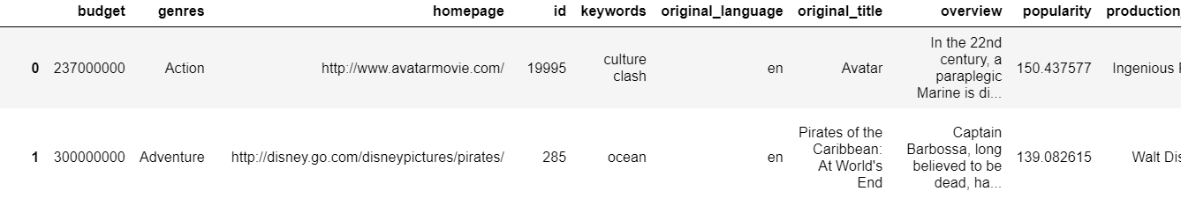
TASK 5
Remove rows with value 0 from both the budget and revenue columns
Remove rows with value 0 from both the budget and revenue columns
Interpretation
The rows with either zero budget or zero revenue indicate insufficient data for that movie. Since these values affect the analysis, they have been deleted.

Slide 12
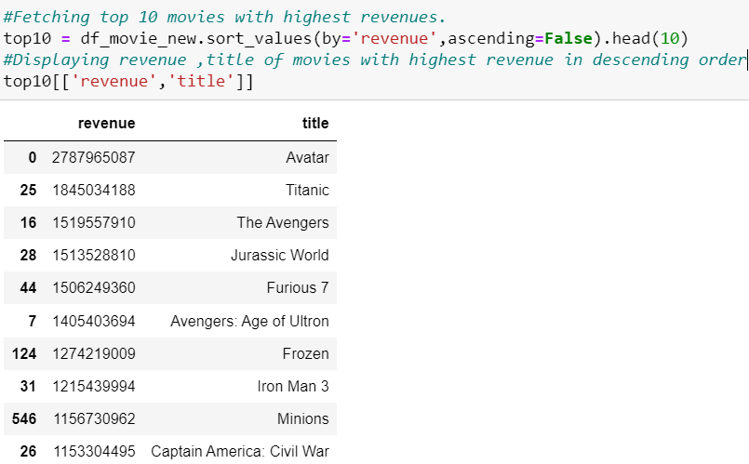
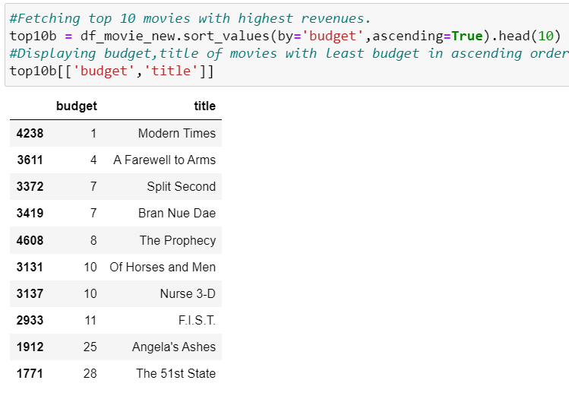
TASK 6
Top 10 movies with the highest revenues
Top 10 movies with the least budgets
Interpretation
The movie with the highest revenue is Avatar
The movie with the lowest budget is Modern Times

Slide 13
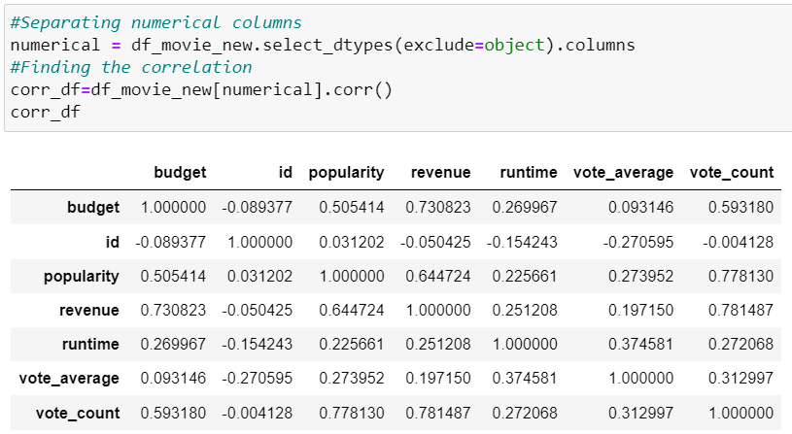
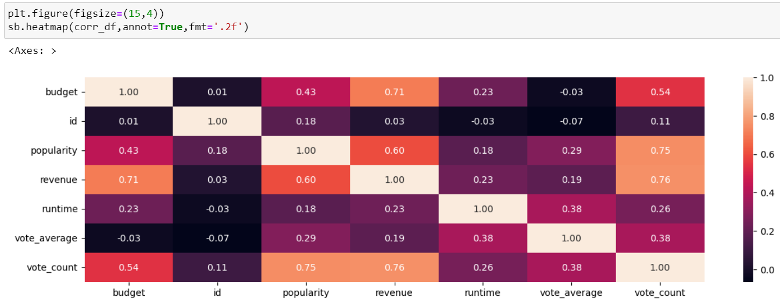
TASK 7
How are popularities of movies related with the movie budgets
Interpretation
The popularity of movies is positively correlated to budget by 43%. An increase in budget leads to an increase in popularity to a certain extent.

Slide 14
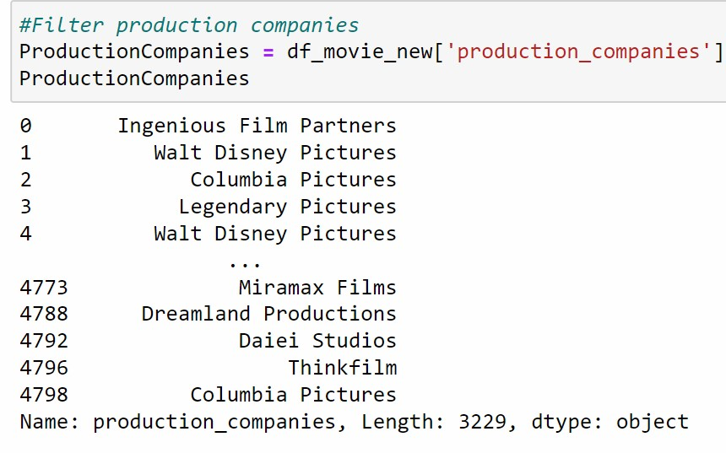
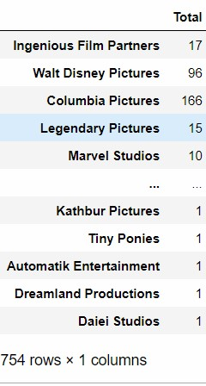
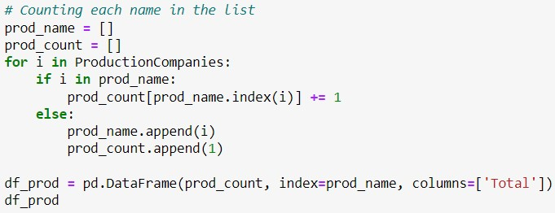
TASK 8
Interpretation
The number of times a production company appears in the dataset indicates the number of movies they have produced.
Names of all production companies along with the number of times they appear in the dataset

Slide 15
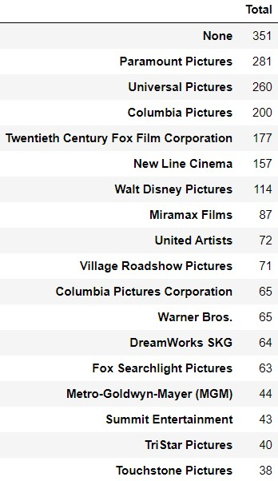
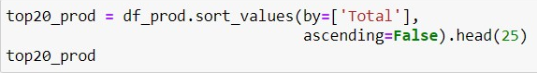
TASK 9
Top 25 production companies based on the number of movies they have produced
Interpretation
The maximum number of movies in this dataset is produced by Paramount Pictures

Slide 16
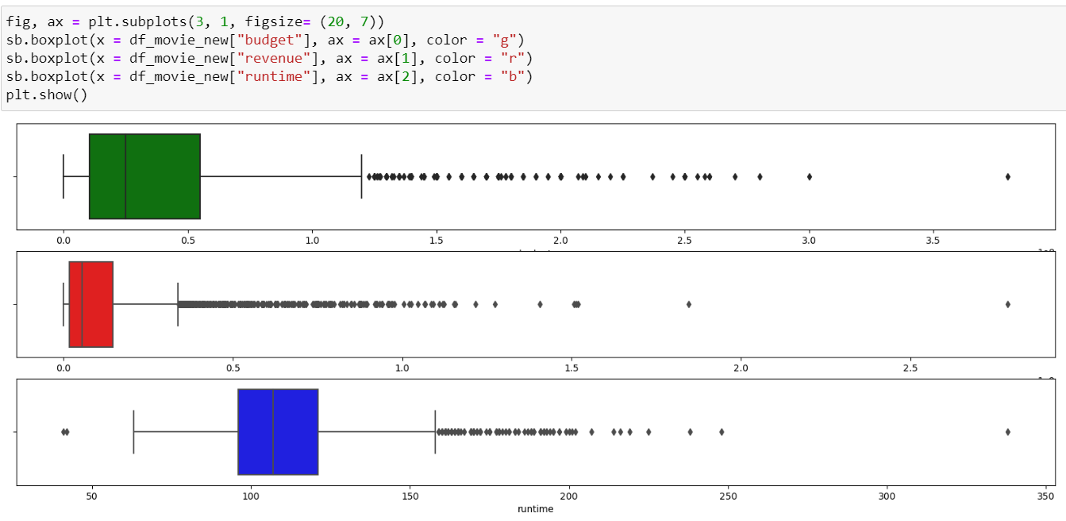
TASK 10
Interpretation
There are outliers on all three columns and the outliers are mostly higher than the upper fence
Outlier Analysis

Slide 17
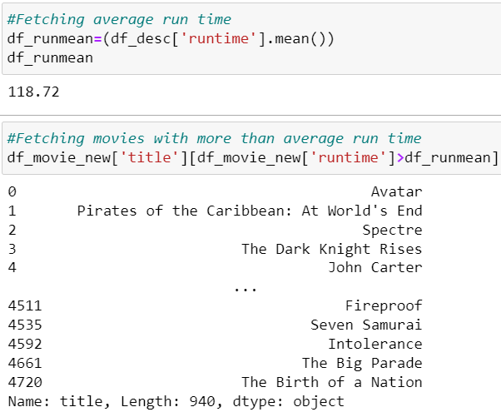
TASK 11
Interpretation
Movies with above average runtime
The average runtime is 118.72 and there are 940 movies with above average runtime.

Slide 18
THANK YOU

